Slide 1
2011 – Vision and Change in Undergraduate Biology Education
Slides courtesy of Dr. Scott Edwards
Director, Division of Biological Infrastructure
(DBI), Directorate for Biological Sciences
(BIO)
1

Slide 2
Research Coordination Networks – Undergraduate Biology Education (RCN-UBE)
NSF’s response:
Research Coordination Networks
in Undergraduate Biology Education (RCN-UBE)
Supports projects to build communities of biology faculty
Incubator awards ($50 K) to fund formation of new teams
Full awards (up to $500K for five years) fund more mature projects
2
Notes:
RCN-UBE
incubator awards allow teams to begin to form themselves with $50K grants for one year of support.
We expect that at least some of the incubator RCN-UBEs will eventually lead to full UBE proposals or TUES proposals.
RCN-UBE and TUES (Transforming Undergraduate Education in STEM) Science, Technology, Engineering and Mathematics

Slide 3
Research Coordination Networks in Undergraduate Biology Education (RCN-UBE)
RCNs foster networking activities and does not directly support…laboratory and field research.
Faculty can submit an incubator proposal first or submit a full proposal first
NSF expects some incubator proposals will lead to full RCN-UBE proposals
Other RCN-UBEs might lead to curriculum development efforts (TUES), research proposals, or REU sites
3

Slide 4
Research Coordination Networks in Undergraduate Biology Education (RCN-UBE)
Goal: “focus on any topic likely to lead to improved participation, learning, or assessment in undergraduate biology curricula”
active and inquiry-based learning
engage faculty in professional development
incorporate new fields into the biology curriculum
improve assessment of student learning
improve transition from 2-year to 4 year institutions
Incorporate authentic research experiences into undergraduate laboratory courses
4

Slide 5
Examples of current RCN-UBE awards
Network in northeast between several small colleges and Pennsylvania State University for genomics research
Network in northwest to improve biology course instruction
Professional society (ASBMB) to improve teaching in biochemistry and molecular biology
AIM-UP! Enhancing undergrad education using museum collections
National network of course-based research experiences (CURE-NET)
Network focusing on introductory biology course experiences (e.g. REIL)
National network of ethnobiologists
5

Slide 6
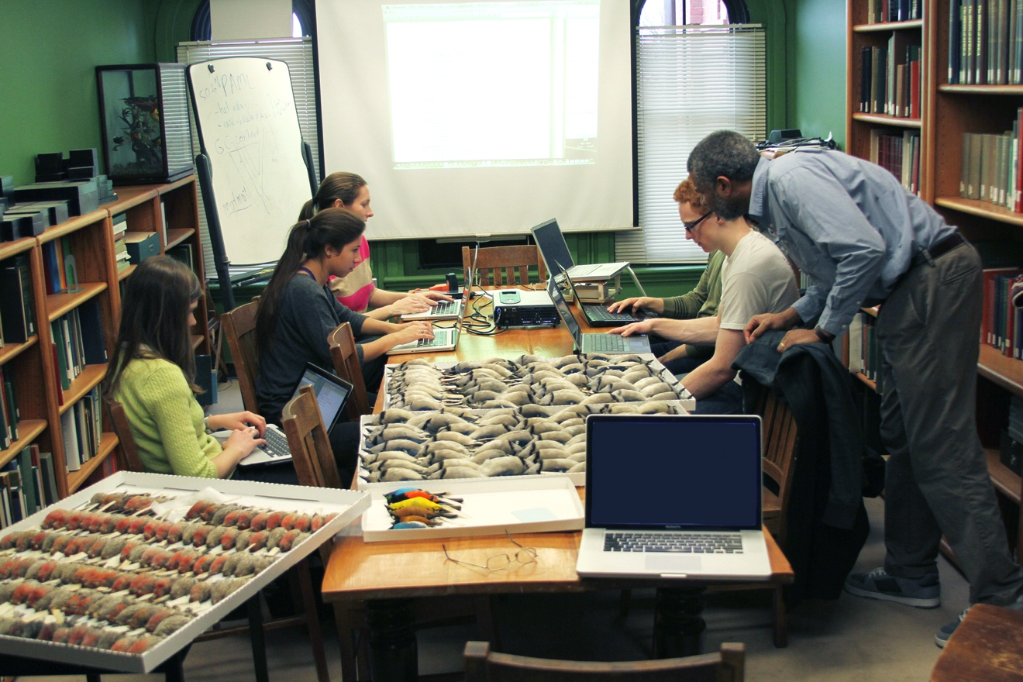
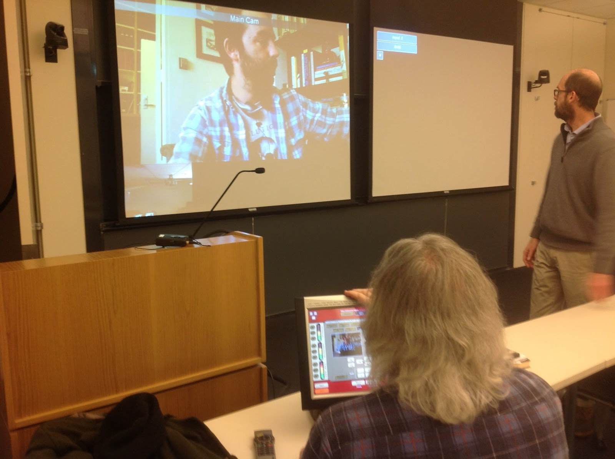
AIM-UP!: Advancing Integration of Museums into Undergraduate Programs http://www.aim-up.org/
PI: Joe Cook, U New Mexico
Participating institutions:
Harvard, Berkeley, U of Alaska, Occidental College, Iowa State, Central Mich U, …

Slide 7
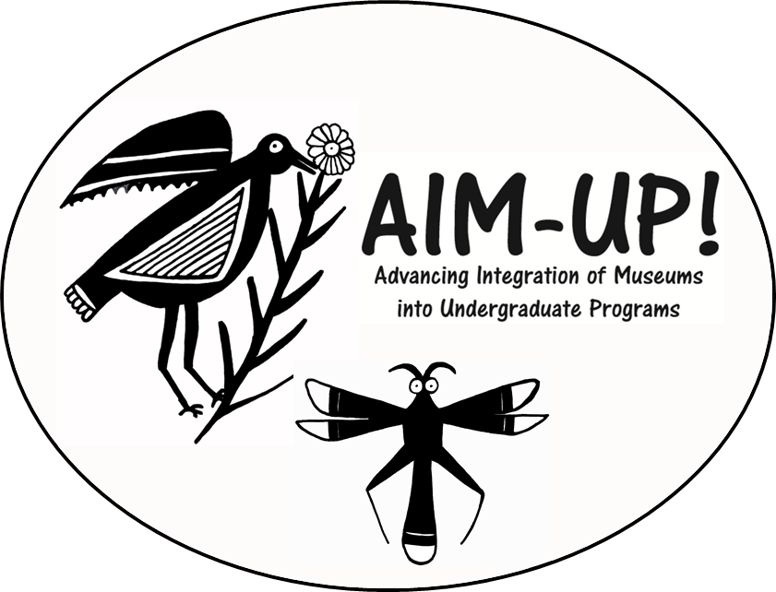
MUSEUM COLLECTIONS AND CLIMATE CHANGE BIOLOGY An Introduction to AIM-UP! Advancing the Integration of Museums into Undergraduate Programs

Slide 9
Value of Museum collections
Historical records, which serve as benchmarks
Material evidence of things in a particular place at a particular time
Define and identify species
Preservation of rare materials

Slide 10
Traditional uses of Museums in Undergraduate Education
Experiences in curation
Experiences in museum field work
Learning through exhibits
Research experiences based on collections
Organismal specimens in teaching collections
Genetic specimens in class projects
Must have access to a museum collection

Slide 11
Endless uses for data!
Describe geographic variation within species
Test hypotheses regarding:
timing of speciation & rates of speciation
species identity
Causes of shell thinning in birds of prey
Levels of inbreeding or hybridization between species
effects of climate change on species distributions and abundances
Temporal & geographic consistency of host-parasite relationships
Temporal & geographic continuity of communities

Slide 12
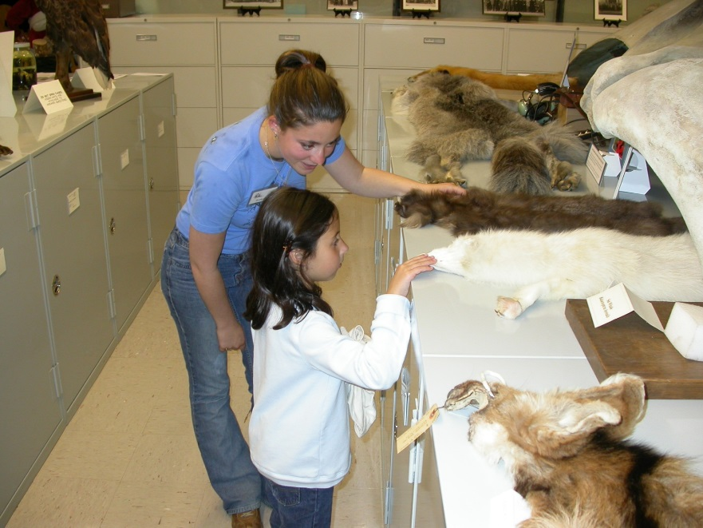
What do collections-based approaches add to undergrad education?
Scale—time and space
Integration
biotic and abiotic
genomic to organismal to ecosystems
Complexity-multiple views
Web-based Discovery
Database Exposure
Scientific Process
Experiential vs passive

Slide 13
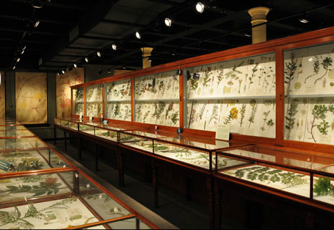
Challenges
Few educators (& fewer students) seem to know:
Where natural history collections are kept
How collections data have been and might be used:
their role in teaching key concepts
potential role in key societal issues
how to access museum collection information
how to incorporate specimen data in teaching and research

Slide 14
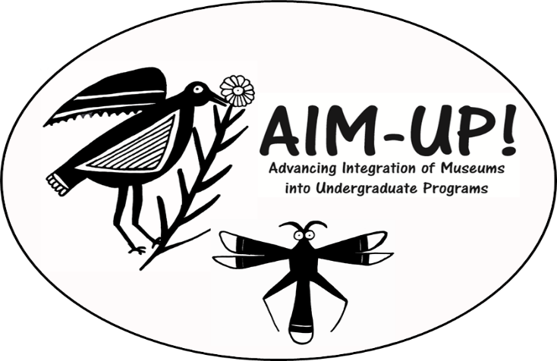
AIM-UP!
Expand traditional museum experiences
Develop novel uses of collections and data.
Increase accessibility of natural history collections to educators/public through databases.
Facilitate on-line use by educators by developing tools, guidelines, and “front-end” entry into databases.
Partner with non-traditional museum users
(e.g., Behavior, Geography, Art)
Develop international collaborations
(Latin America & Spanish language)

Slide 15
AIM-UP!--the network
Universities, Community Colleges and Tribal Colleges:
U Alaska, UC Berkeley, Harvard U, U New Mexico, U Michigan, Texas A&M, U Texas, U Colorado, U Arizona, U Kansas, UAS, UAA, CNM, NM Highlands University, Ohio State U, Occidental College, Northern Arizona University, U of Florida, Massachusetts College of Liberal Arts, University of Idaho, Arizona State U, U of Florida, Tulane, Idaho State U, Northern Michigan U, Central Michigan U, U Nebraska, Seattle Central College
Agencies and Free-standing Museums: USDA National Parasite Lab, USGS Molecular Ecology Lab, USNM, Denver Museum of Nature & Science, NY State Museum
International: U Guelph, U Nacional de la Republica, Montevideo,
High Schools: Highland High (urban) and Sitka High (rural)

Slide 16
Products & Goals
Better Understanding of Existing Programs
Survey of Educators and Students
Stimulate Interdisciplinary Use of Specimens
Publications—
Perspectives, Surveys, Educational Venues, Texts
Workshops
Educational (Dispersion) modules centered around fundamental principles
Grow the Community of Users

Slide 17
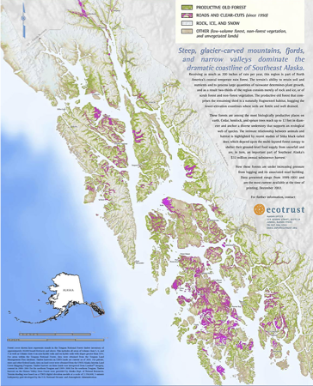
Educational Modules
Island Biogeography:
Species Richness Across a Northern Archipelago
Key Concepts and Skills:
Evolution & Ecology
Body size on islands
Competitive exclusion/release
Isolation and Divergence
Island biogeography
Conservation biology
Scientific process & hypothesis testing
Statistical methods
Management & analyses of large-scale databases

Slide 18
Educational Modules
Reading, Constructing, & Using Phylogenies
Key Concepts and Skills
Learn scientific process
Gain appreciation for evolutionary connections across the Tree of Life
Interpret a phylogeny
Construct phylogenetic trees
Introduce different methods to study evolutionary relationships
Learn how biologists use comparative phylogenetics to contextualize the biology of organisms

Slide 19
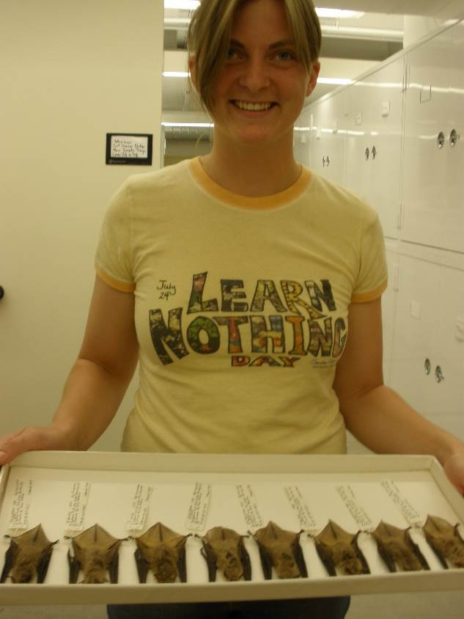
Annual Conceptual Themes:
1) Integrative Inventories: Exploring Complex Biotic Associations Across Space and Time (MSB)
2) Decoding Diversity: Making Sense of Geographic Variation (UAM)
3) Evolutionary Dynamics of Genomes (MCZ)
4) Biotic Response to Climate Change (MVZ)
5) Coevolving Communities and the Human Dimension (MSB)

Slide 20
Research Methods in Plant Evolutionary Biology: From Field to Museum to Molecular Lab
BOT 4935
University of Florida
Pam and Doug Soltis

Slide 21
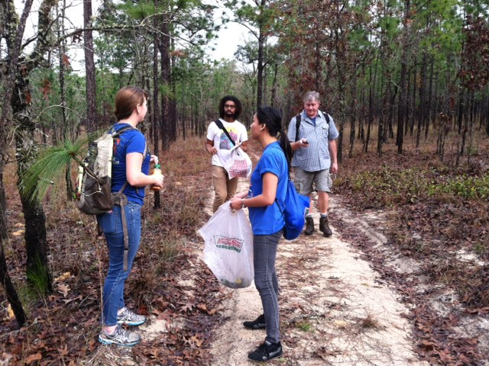
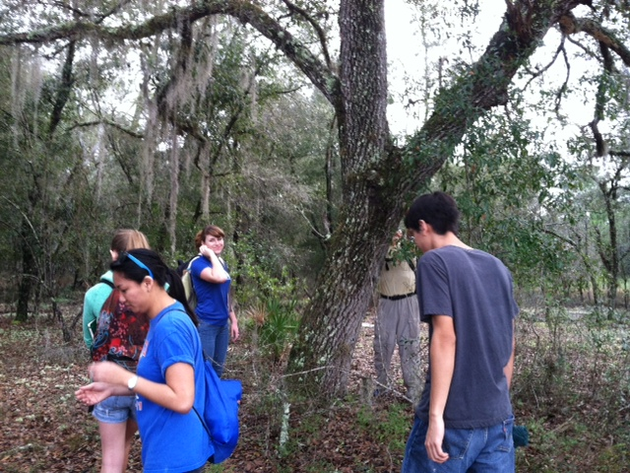
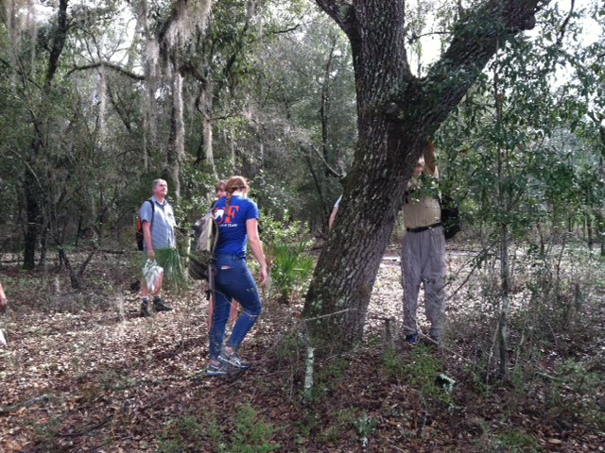
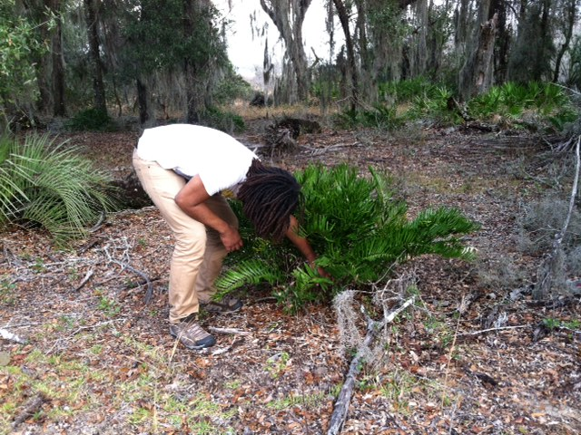
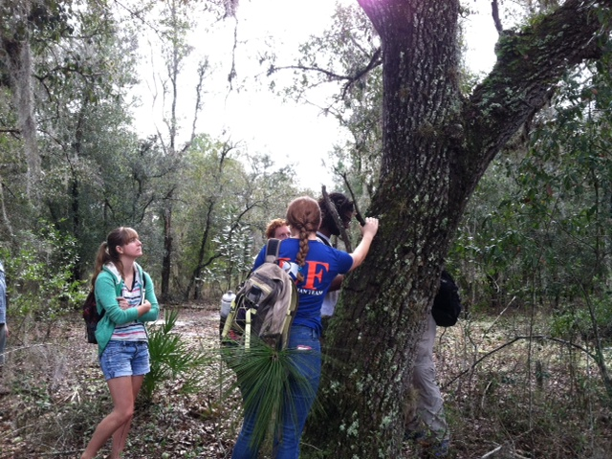

Slide 22
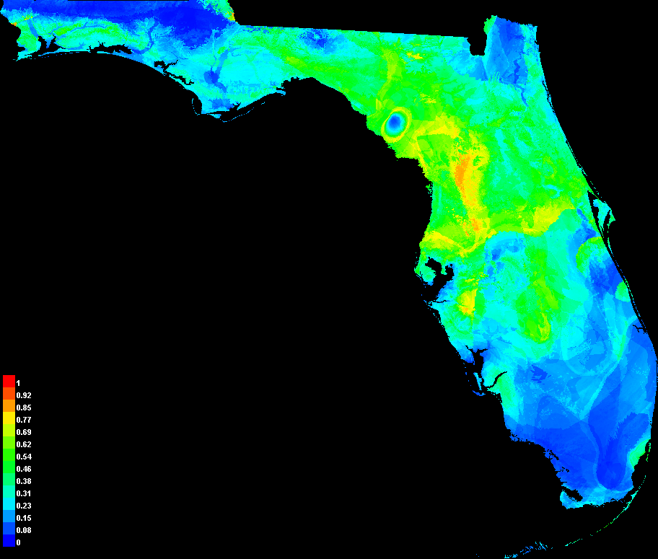
Niche Modeling - Present/Future
Layers (Bio6-Min Cold Month/Bio6&9- Mean Temp Driest Quart)
Goal

Slide 23
What Have the Students Learned So Far?
How to collect, prepare, digitize, and database herbarium specimens
Many uses of museum specimens
Basic georeferencing and niche modeling
How to integrate knowledge from courses into research applications

Slide 24
What Have We Learned So Far?
Students are really smart and enthusiastic!
We don’t challenge them enough in traditional courses
Experiential courses are way more fun!
Filtering students important for obtaining a successful group

Slide 25
What have we learned about research experiences?
Students are more invested in self-guided work.
Authentic research experiences motivate students & increase persistence
Connectedness to a project, goal or group can improve achievement of learning outcomes

Slide 26
Opportunities for student contribution and database use
Citizen Science databases
Global Biodiversity Information Facility (GBIF)
iNaturalist
eBird

Slide 27
Accessible databases for student use
NCBI
GenBank, etc.
Arctos – All types of museum specimens
VertNet – All Vertebrate museum specimens
NEON – National Ecological Observatory Network; abiotic factors
iDigBio – Integrated Digitization Biocollections; data & images

Slide 28
Evaluations
Most modules have evaluations
You can help!
Ongoing effort to standardize across modules
What is missing from these evaluations?
Identify the biggest barrier or reservation to implementing these modules.

