Slide 1
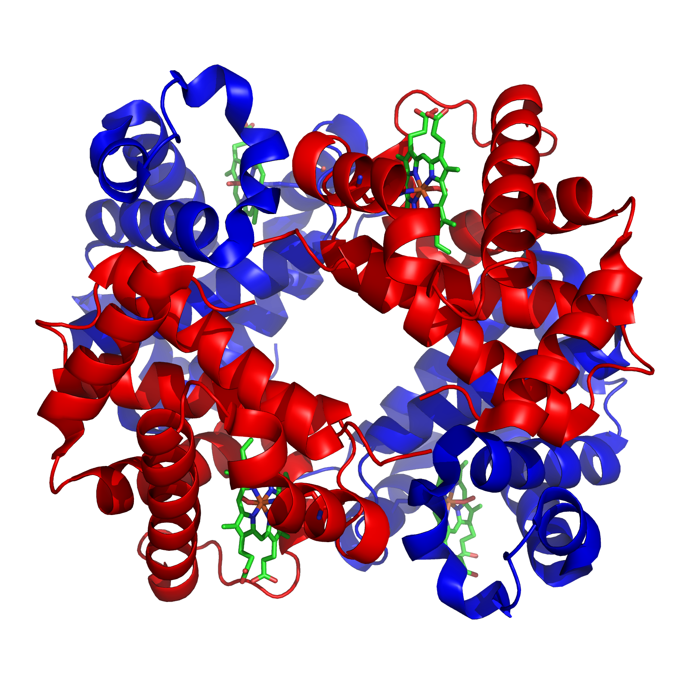
Hemoglobin Function and Variation in Wild Populations

Slide 2
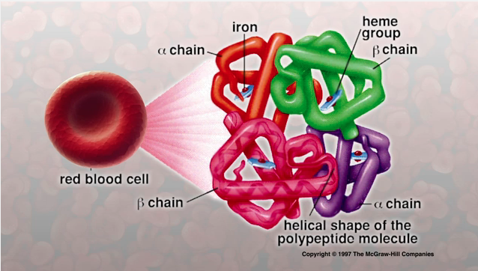
What is Hemoglobin?
Hemoglobin is a protein in red blood cells that binds to oxygen in the lungs and carries the oxygen to the tissues.

Slide 3
What is Hemoglobin?
Hemoglobin has a tetrameric structure; it is made up of four subunits (2 α chains and 2 β chains) bound together.
Each subunit contains a heme group that can bind one molecule of oxygen (O₂).

Slide 4
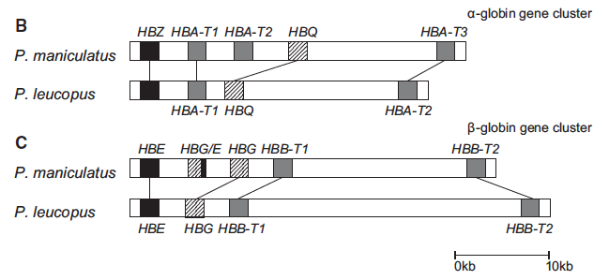
Hemoglobin in the genome:
Multiple genes can produce functional α hemoglobin (HBA) subunits.
The related HBA genes, known as a gene family, are located near one another on the same chromosome.
There is a similar β hemoglobin (HBB) chain gene family.
Location of genes in HBA and HBB gene families in deer mice.
Modified Fig. 1 from Natarajan et al. 2015. Molecular Biology and Evolution

Slide 5
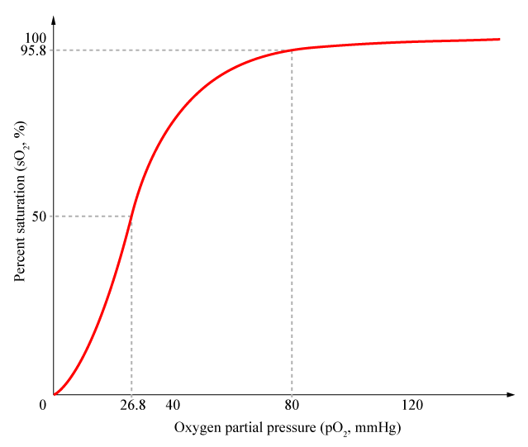
Hemoglobin-O₂ dissociation curves
High P_{O2}
Many Hb w/ bound O₂
P₅₀ : P_{O2} where 50% of Hb have bound O₂
Low P_{O2}
Few Hb w/ bound O₂
The shape of the curve is sigmoidal; this is due to cooperative binding of oxygen to hemoglobin.
Notes:
The oxygen-hemoglobin dissociation curve describes the relationship between partial pressure of oxygen (x axis) and the oxygen saturation (y axis).
At low oxygen partial pressure (P_{O2}), few hemoglobin proteins have bound any oxygen. As P_{O2} increases, the number of hemoglobin proteins that have bound oxygen and the amount of oxygen that is bound rapidly increase, resulting in a sigmoidal curve. This shape of the curve is the result of the cooperative binding of oxygen to hemoglobin; as oxygen binds to hemoglobin, it results in a conformational change that increases the affinity of hemoglobin to O₂. This makes it easier for Hb to bind MORE oxygen once it has bound a single oxygen molecule.
At high P_{O2}, hemoglobin becomes saturated, meaning it has bound 4 oxygen molecules to nearly all available hemoglobin molecules.
This characteristic shape describes the affinity of hemoglobin to oxygen.

Slide 6
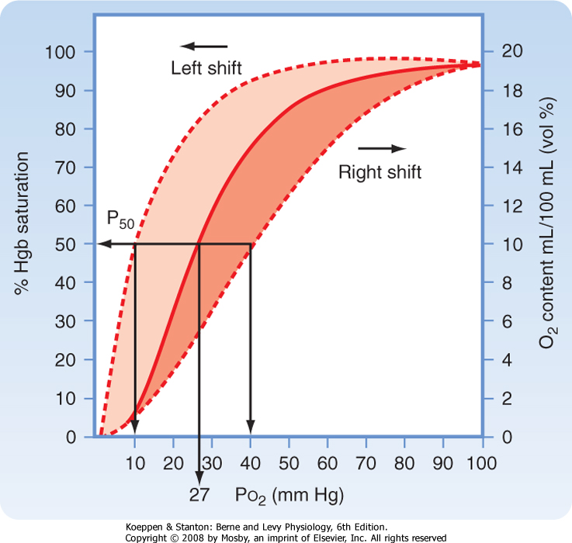
The O₂ dissociation curve (ODC) describes the Hb-O₂ affinity of hemoglobin under certain environmental conditions.
Notes:
The oxygen-hemoglobin dissociation curve describes the relationship between partial pressure of oxygen (x axis) and the oxygen saturation (y axis).
This characteristic shape describes the affinity of hemoglobin to oxygen under a specific set of environmental conditions (pH, presence of organic phosphates, other allosteric affectors).

Slide 7
Different Hb-O₂ dissociation curves describe hemoglobin molecules with different O₂ affinity.
Differences in affinity can be due to evolutionary history (natural selection, population history etc.)
Affinity differences can also be due to environmental conditions.
Lower P₅₀
Higher Hb-O₂ affinity
Higher P₅₀
Lower affinity
Notes:
Depending on the species, hemoglobin-oxygen affinity may be higher or lower. A species with a left-shifted ODC has a higher affinity for O2 – the hemoglobin of this species binds O2 more easily.
The P₅₀ helps describe the Hb-O2 affinity; it is the partial pressure of O₂ at which 50% of all hemoglobin molecules have bound oxygen.
A higher P₅₀ describes a lower affinity for hemoglobin and oxygen. A lower P₅₀ describes a higher affinity; oxygen will bind more easily to a hemoglobin with a lower P₅₀.
The Hb-O2 binding curve can also be impacted by the environmental conditions (chemical conditions) in which the hemoglobin is acting – see next slide.

Slide 8
TENSE state
Hb has low O₂ affinity
RELAXED state
Hb has high O₂ affinity
HB allosteric affectors:
Cl⁻ : Chloride ions
H⁺ : protons (pH)
OPH : Organic phosphates
vary across species
T
R
Notes:
This is a reversible reaction between two conformations of hemoglobin, the T (tense) state and the R (relaxed) state. The two states have different affinities for oxygen.
In addition to oxygen, hemoglobin may also bind several allosteric affectors (not all of which are listed!). The presence of allosteric affectors H⁺, Cl⁻ and organic phosphates (OPH) can impact the proportion of Hb molecules in the T and R state. These allosteric affectors stabalize the T state (the low affinity state), resulting fewer Hb bound to O₂ at a particular partial pressure of oxygen (see next slide).

Slide 9
Presence of allosteric affectors impact Hb-O₂ binding
P₅₀ stripped
P₅₀ + Cl⁻
P₅₀ + OPH

Slide 10
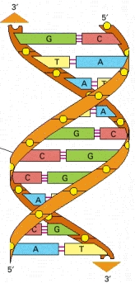
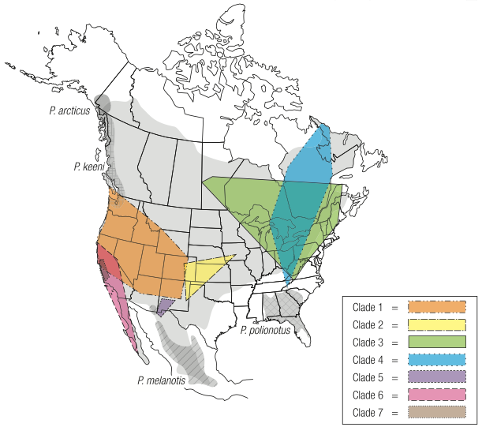
Today’s challenge:
Notes:
Today’s challenge will be to use your knowledge of hemoglobin function to integrate from the chemical level to the whole organism level up to populations
From (1) DNA to (2) amino acid substitutions that affect (3) hemoglobin protein function which (4) impacts the biology of a whole organism and (5) can be the target of natural selection among natural populations, which can facilitate changes in (1) DNA sequences

Slide 11
Lab today
Activity I: Genetic variation and functional consequences in HBA in deer mice.
Assess genetic variation in HBA genes.
Assess structural consequences of HBA variation in hemoglobin function.
Activity II: Testing for heritable, functional variation and natural selection in HBB.
Use Hb-O₂ binding curve to discover source of functional variation in HBB.
Design experiment to test natural selection on HBB in deer mice.

Slide 13
What does it mean to genetically adapted to chronic hypoxia?
Genetically adapted – DNA based trait that confers a benefit for survival
Chronic hypoxia – persistent deficiency in oxygen
Notes:
Organisms that have genetic adaptions to low oxygen environments have evolved genetically based mechanisms to cope with lower partial pressure of oxygen and deliver sufficient amounts of oxygen to the tissues.

Slide 14
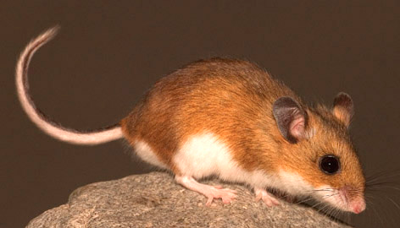
Why do the deer mice the alleles a⁰c⁰ (high-elevation alleles) perform worse at low elevations than mice with a¹c¹ (low-elevation) alleles?
a⁰c⁰
a¹c¹
Notes:
Page 29 in the reading – the high-affinity a⁰c⁰ alleles probably hinder the release of oxygen in low altitude environments with relatively high partial pressure of oxygen.

Slide 15
List the independent lineages mentioned in Storz (2007) in which hemoglobin modifications have occurred that resulted in a left-shifted oxygen-dissociation curve.
Notes:
high flying birds (Bar-headed goose – awesome example); vicuña, llamas and other camelids; deer mice
A left shift means that hemoglobin has a higher affinity for oxygen binding and a right shift means hemoglobin has a lower affinity for oxygen binding. Different factors (Environment conditions, evolutionary history) can lead to shifts in either direction.
A left shift means that hemoglobin will bind oxygen more easily at lower partial pressures of oxygen.
- TAs: A left shift will help an organism gain O2 from the atmosphere at the blood-air barrier in the lungs
A right shift means that hemoglobin will drop oxygen more easily at higher partial pressures of oxygen.
- TAs: A right shift will help an organism deliver O2 to tissues; an example of this is the Bohr effect which results from a rise in pH.

Slide 16
In addition to living at high elevations, what other environmental conditions may result in genetic adaptation to hypoxia?
Considering this, what other organisms may have modified oxygen-carrying proteins?
Notes:
Where is oxygen scarce? Burrowing! Diving! Aerial migration (transitory)!

Slide 17
Lab Activity 1
Use a natural history collection database (Arctos) to find the records for some of the specimens used in the Storz et al. 2007 PLOS Genetics paper.
Then look at the GenBank record of the hemoglobin sequence for at least one individual.
Determine the frequencies of each hemoglobin alpha allele in your population. Draw a pie chart for each of your alleles (5 pie charts total).
Notes:
TAs: Pause here for students to work their way, in groups through Activity I, Tasks 1-3.
Also, draw large map with the following features on board:
East/west border between Kansas and Colorado near center, label Kansas on right and Colorado on left
Tall mountains on left hand edge of map (in Colorado); triangles are fine! Label this site “Mt. Evans, CO” at top. Students will draw the Mt. Evans allele frequency pie charts below this label.
foothills closer to Colorado side of Colorado/Kansas border. Label this site “Bonny Reservoir, CO” at top. Students should draw pie charts below this label.
Label site east of Colorado/Kansas border “Fort Larned, KS”
Recommendation: Make sure students label the position of their pie charts and the amino acid represented by each slice in their pie! You can even label spots for each pie chart – pos. 50 on top, then pos. 57 in middle, then pos. 64 on bottom for each location.
When students have finished those tasks, come back together as a class to discuss geographic allele frequency shifts (pie charts drawn on board)

Slide 18
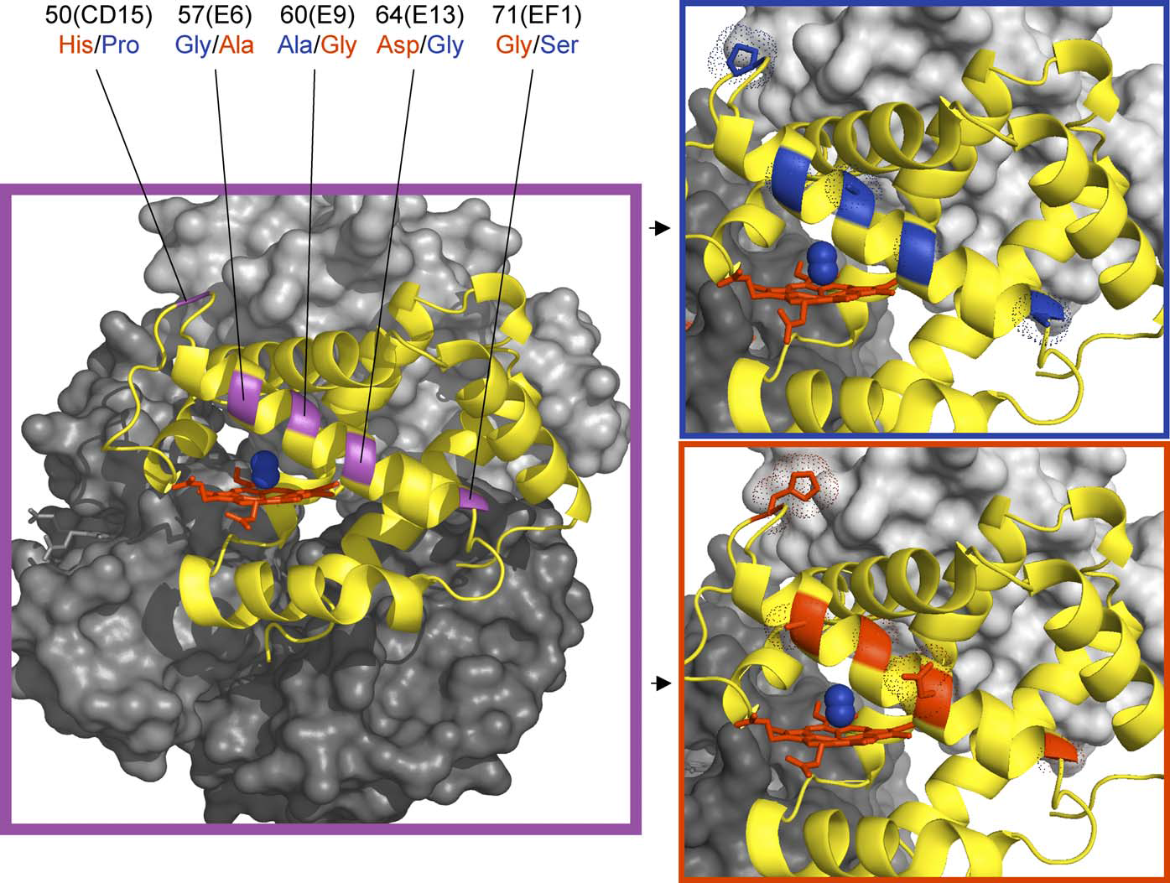
Figure 4 in Storz et al. 2007
Notes:
Figure 4 with the labels for the 5 amino acid changes the students are looking at.

Slide 19
Figure 4 in Storz et al. 2007. Form a hypothesis about which amino acid change or changes might be most important for oxygen binding and explain.
Common amino acids at high elevations
Common amino acids at low elevations
Notes:
This projected might make it easier for the students to see the differences in the amino acid sequences.

Slide 20
Figure 4 in Storz et al. 2007. Form a hypothesis about which amino acid change or changes might be most important for oxygen binding and explain.
Common amino acids at high elevations
Common amino acids at low elevations
Notes:
The side chain on the 64th amino acid (aspartic acid) in low elevations is hypothesized to interfere with oxygen binding (circled in green).

Slide 21
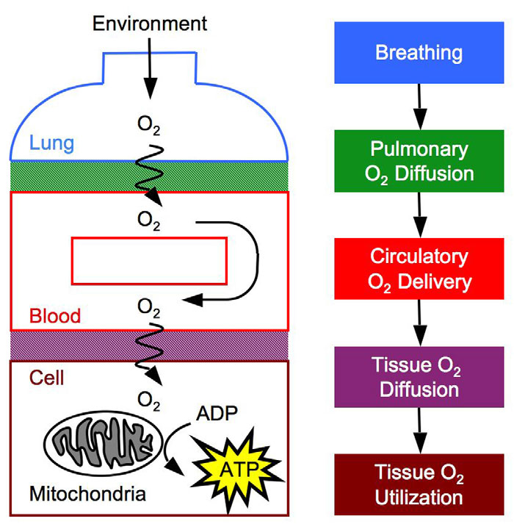
Fig. 1 from Storz et al. (2010)
Notes:
Look at Figure 1 (top left) from Storz et al. 2010 Journal of Experimental Biology
Is HB more likely to grab oxygen or drop it at each of stage on the diagram? Where would that be (approximately) on the disassociation curve?
A left shift means that hemoglobin will bind oxygen more easily at lower partial pressures of oxygen.
- TAs: A left shift will help an organism gain O2 from the atmosphere at the blood-air barrier in the lungs
A right shift means that hemoglobin will drop oxygen more easily at higher partial pressures of oxygen.
- TAs: A right shift will help an organism deliver O2 to tissues.
- An example of a right shift is the Bohr effect which results from a rise in pH due to actively respiring tissues (produce CO2, which react with H20 to produce H+, raising pH in respiring tissues and stimulating Hb to drop O2.

